Slide 1
Stack

Slide 2











DATA
STRUCTURE
LINEAR DATA
STRUCTURE
NON LINEAR DATA STRUCTURE
ARRAY
QUEUE
STACK

Slide 3

Stack (Last in First Out)
A stack is an Abstract Data Type (ADT), commonly used in most programming languages. It is named stack as it behaves like a real-world stack, for example – a deck of cards or a pile of plates, etc.
A stack is called a last-in-first-out (LIFO) collection. This means that the last thing we added (pushed) is the first thing that gets pulled (popped) off.
A stack is a sequence of items that are accessible at only one end of
the sequence

Slide 4

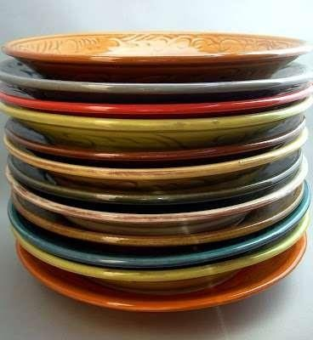
EXAMPLES OF STACK:

Slide 5
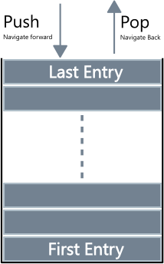
Basic Operations
PUSH(Insertion)
POP (Deletion)
PEEK

Slide 6
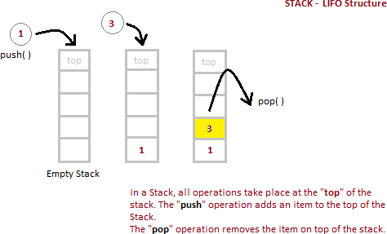
Example

Slide 7
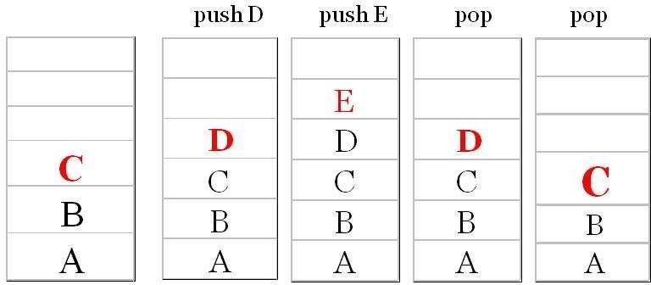
Example of Stack

Slide 8
Implementation
In the array implementation, we would:
Declare an array of fixed size (which determines the maximum size of the stack).
Keep a variable which always points to the “top” of the stack.
Contains the array index of the “top” element.
In the linked list implementation, we would:
Maintain the stack as a linked list.
A pointer variable top points to the start of the list.
The first element of the linked list is considered as the stack top.

Slide 9
PUSH Operation(Array)
In a stack, push() is a function used to insert an element into the stack. In a stack, the new element is always inserted at top position. Push function takes one integer value as parameter and inserts that value into the stack. We can use the following steps to push an element on to the stack...
PUSH(STACK, N, TOP, ITEM)
If TOP=N-1: //LB=0
then write OVERFLOW, and Return.
Set TOP := TOP + 1.
Set STACK[TOP]:= ITEM.
Return.

Slide 10
POP Operation(Array)
In a stack, pop() is a function used to delete an element from the stack. In a stack, the element is always deleted from top position. Pop function does not take any value as parameter. We can use the following steps to pop an element from the stack...
POP(STACK, N, TOP, ITEM)
If TOP = -1 then : //LB=0
write: UNDERFLOW, and Return.
Set ITEM := STACK [TOP].
Set TOP := TOP - 1.
Return.

Slide 11
PEEK Operation
When we need to return the value of the topmost element of the Stack without deleting it from the Stack, the Peek operation is used. This operation first checks if the Stack is empty, i.e., TOP = NULL; if it is so, then an appropriate message will display, else the value will return.
Step-1: If TOP = NULL
PRINT “Stack is Empty”
Goto Step 3
Step-2: Return Stack[TOP]
Step-3: END

Slide 12
Push Operation on a Linked Stack
Algorithm to PUSH an element in a linked stack
Step 1: Allocate memory for the new node and name it as New_Node
Step 2: SET New_Node->DATA = VAL
Step 3: SET New_node->NEXT = TOP
SET TOP = New_Node
[END OF IF]
Step 4: END
1
7
3
4
2
6
5
X
TOP
9
1
7
3
4
2
6
5
X
TOP

Slide 13
Pop Operation on a Linked Stack
Algorithm to POP an element from a stack
Step 1: IF TOP = NULL, then
PRINT “UNDERFLOW”
Goto Step 5
[END OF IF]
Step 2: SET PTR = TOP
Step 3: SET TOP = TOP ->NEXT
Step 4: FREE PTR
Step 5: END
9
1
7
3
4
2
6
5
X
TOP
1
7
3
4
2
6
5
X
TOP

Slide 14
Peek Operation on a Linked Stack
Algorithm to PEEK an element from a stack
Step 1: IF TOP = NULL, then
PRINT “UNDERFLOW”
Goto Step 5
[END OF IF]
Step 2: RETURN TOP->data
Step 3 END
See example for the implementation
9
1
7
3
4
2
6
5
X
TOP

Slide 15
Implementation
int push(int data) {
int isfull() {
if(!isfull()) {
top = top + 1; stack[top] = data;
} else {
printf("Could not insert data, Stack is full.\n");
}
if(top == MAXSIZE) return 1;
else
return 0;
}
}
int isempty() {
int pop() { int data;
if(top == -1)
return 1;
else
return 0;
if(!isempty()) {
data = stack[top]; top = top - 1; return data;
} else {
printf("Could not retrieve data, Stack is empty.\n");
}
}
int peek() {
return stack[top];
}
}

Slide 16
Applications of Stacks
Reversing a list
Parentheses checker
Conversion of an infix expression into a postfix expression
Evaluation of a postfix expression
Conversion of an infix expression into a prefix expression
Evaluation of a postfix expression
Recursion
Tower of Hanoi

Slide 17
Reversing a List
Read each letter in the word and push it onto the stack
When you reach the end of the word, pop the letters off the stack and print them out.

Slide 18
Parentheses Checking
Parentheses -- (, ) Used mathematic expression in enforce precedence of operation
Example: A + (B + C)*D Well-nested or valid, e.g. (a+b)*(a-b), Not valid: . (a+(b)*(a-b)
Similarly [, ] , {,} used in programing language
In parsing the source, need to check if parentheses are well-nested.
Further generation for mark-up language, like HTML, tags needs to be well-nested.
How to check if parentheses are valid

Slide 19
Example:
VALID INPUTS | INVALID INPUTS
{ } | { ( }
( { [ ] } ) | ( [ ( ( ) ] )
{ [ ] ( ) } | { } [ ] )
[ { ( { } [ ] ( {})}] | [ { ) } ( ] } ]

Slide 20
Infix Notation
Infix, Postfix and Prefix notations are three different but equivalent notations of writing algebraic expressions.
While writing an arithmetic expression using infix notation, the operator is placed between the operands. For example, A+B; here, plus operator is placed between the two operands A and B.
Although it is easy to write expressions using infix notation, computers find it difficult to parse as they need a lot of information to evaluate the expression.
Information is needed about operator precedence, associativity rules, and brackets which overrides these rules.
So, computers work more efficiently with expressions written using prefix and postfix notations.

Slide 21
Infix Notation
To add A, B, we write
A+B
To multiply A, B, we write
A*B
The operators ('+' and '*') go in between the operands ('A' and 'B')
This is "Infix" notation.

Slide 22
Postfix Notation
Postfix notation was given by Jan Łukasiewicz who was a Polish logician, mathematician, and philosopher. His aim was to develop a parenthesis-free prefix notation (also known as Polish notation) and a postfix notation which is better known as Reverse Polish Notation or RPN.
In postfix notation, the operator is placed after the operands. For example, if an expression is written as A+B in infix notation, the same expression can be written as AB+ in postfix notation.
The order of evaluation of a postfix expression is always from left to right.

Slide 23
Postfix Notation
Another alternative is to put the operators after the operands as in
A B +
and
A B *
This is Postfix notation.
Notes:
"A,B are multiplied"
"A,B are added"

Slide 24
Prefix Notation
In a prefix notation, the operator is placed before the operands.
For example, if A+B is an expression in infix notation, then the corresponding expression in prefix notation is given by +AB.
While evaluating a prefix expression, the operators are applied to the operands that are present immediately on the right of the operator.
Prefix expressions also do not follow the rules of operator precedence, associativity, and even brackets cannot alter the order of evaluation.
The expression (A + B) * C is written as:
*+ABC in the prefix notation

Slide 25
Prefix Notation
Instead of saying "A plus B", we could say "add A,B " and write
+ A B
"Multiply A,B" would be written
* A B
This is Prefix notation.

Slide 26
The terms infix, prefix, and postfix tell us whether the operators go between, before, or after the operands.
Pre A In B Post

Slide 27
Parentheses
Evaluate 2+3*5.
+ First:
(2+3)*5 = 5*5 = 25
* First:
2+(3*5) = 2+15 = 17
Infix notation requires Parentheses.

Slide 28
What about Prefix Notation?
+ 2 * 3 5 =
= + 2 * 3 5
= + 2 15 = 17
* + 2 3 5 =
= * + 2 3 5
= * 5 5 = 25
No parentheses needed!

Slide 29
Postfix Notation
2 3 5 * + =
= 2 3 5 * +
= 2 15 + = 17
2 3 + 5 * =
= 2 3 + 5 *
= 5 5 * = 25
No parentheses needed here either!

Slide 30
Conclusion:
Infix is the only notation that requires parentheses in order to change the order in which the operations are done.

Slide 31
Precedence Rule
P- paranthesis
E- Exponent
M- MultiplyD- Divide
A- Addition, S- Subtraction.

Slide 32
A. Convert the expression in Reverse Polish notation (post-fix notation):
3+4*5/6
1. 3+4*5/6
2. 3+45*/6
3. 3+45*6/
4. 345*6/+
( ( A + B ) - C * ( D / E ) ) + F
1. ( ( A + B ) - C * ( D / E ) ) + F
2. (AB+ - C * DE/ ) + F
3. (AB+ - CDE/*) + F
AB+CDE/*- + F
AB+CDE/*-F+

Slide 33
A. Convert the expression in Reverse Polish notation (post-fix notation):
Scan the Infix expressionfrom left to right for tokens (Operators, Operands & Parentheses) and perform the steps 2 to 5 for each token in the Expression.
If token is operand, Append it in postfix expression
If token is a left parentheses “(“, push it in stack
If token is an operator,
Pop all the operators which are of higher or equal precedence then the incoming token and append them (in the same order) to the output Expression.
After popping out all such operators, push the new token on stack.

Slide 34
A. Convert the expression in Reverse Polish notation (post-fix notation):
If “)” right parentheses is found,
Pop all the operators from the Stack and append them to Output String, till you
encounter the Opening Parenthesis “(“.
Pop the left parenthesis but don’t append it to the output string (Postfix notation does not have brackets).
6. When all tokens of Infix expression have been scanned. Pop all the elements from the stack and append them to the Output String.
The Output string is the Corresponding Postfix Notation.

Slide 35
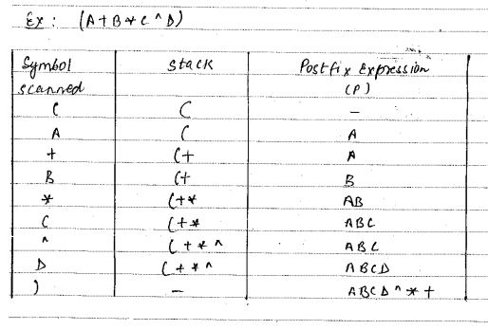
Infix to Postfix Conversion

Slide 36
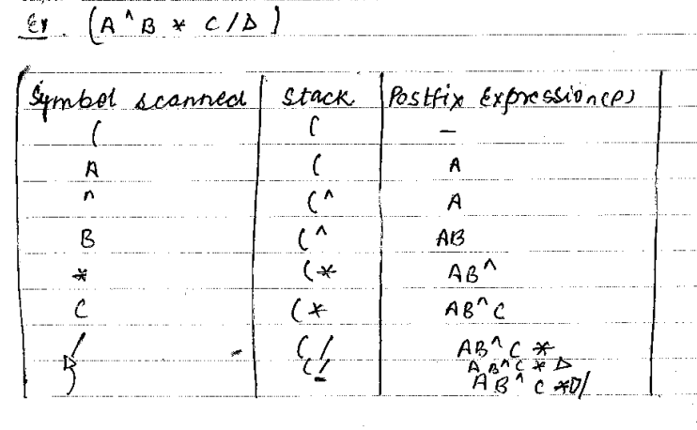
Infix to Postfix Conversion

Slide 37
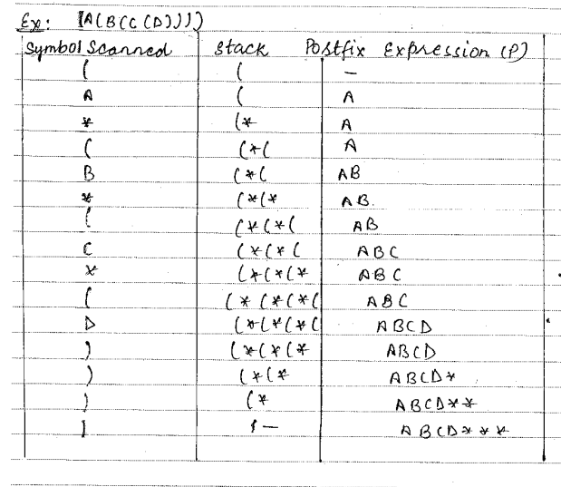
Infix to Postfix Conversion

Slide 38
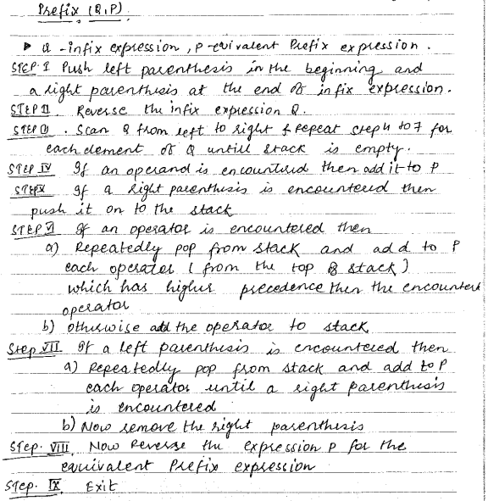
Infix to Prefix Conversion

Slide 39
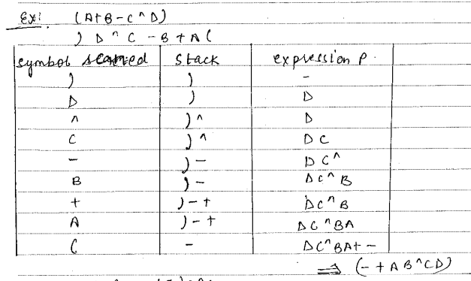
Infix to Prefix Conversion

Slide 40
Evaluate the prefix expression
Algorithm to evaluate a postfix expression
Step 1: Add a “(” in the begining of the prefix expression
Step 2: Scan every character of the prefix expression from right to left and repeat
steps 3 until “(”is encountered
Step 3: IF an operand is encountered, push it on the stack
IF an operator X is encountered, then
a. pop the top two elements from the stack as A and B
b. Evaluate A X B, where A was the topmost element and B
was the element below A.
c. Push the result of evaluation on the stack
[END OF IF]
Step 4: SET RESULT equal to the topmost element of the stack
Step 5: EXIT

Slide 41
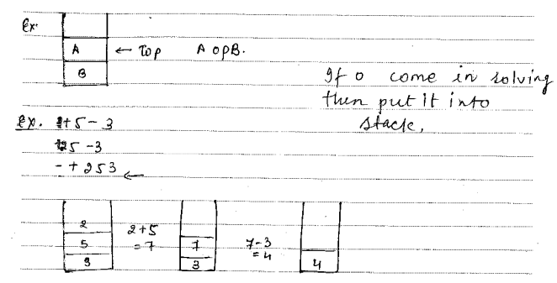
Evaluate the prefix expression

Slide 42
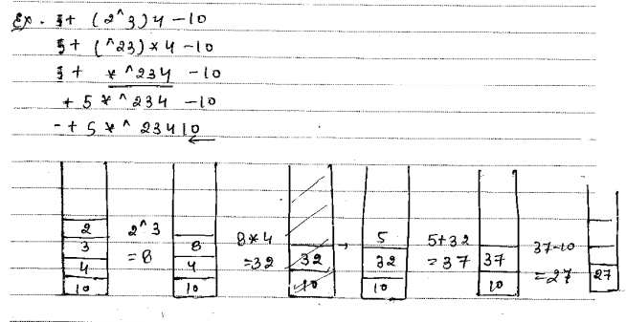
Evaluate the prefix expression

Slide 43
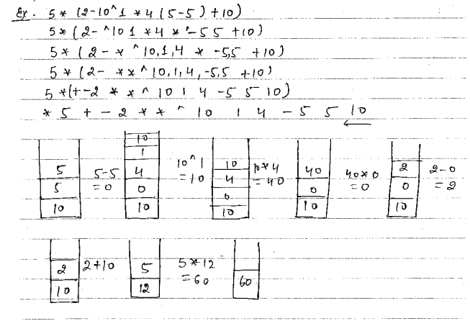
Evaluate the prefix expression

Slide 44
Evaluate the postfix expression
Algorithm to evaluate a postfix expression
Step 1: Add a “)” at the end of the postfix expression
Step 2: Scan every character of the postfix expression from
left to right and repeat
steps 3 and 4 until “)”is encountered
Step 3: IF an operand is encountered, push it on the stack
IF an operator X is encountered, then
a. pop the top two elements from the stack as A and B
b. Evaluate B X A, where A was the topmost element and B was the element below A.
c. Push the result of evaluation on the stack
[END OF IF]
Step 4: SET RESULT equal to the topmost element of the stack
Step 5: EXIT

Slide 45
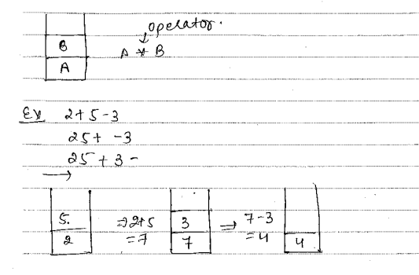
Evaluate the postfix expression

Slide 46
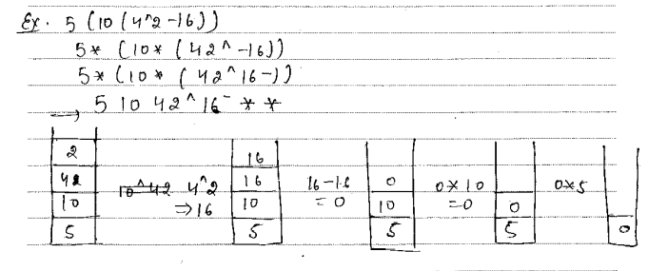
Evaluate the postfix expression

Slide 47
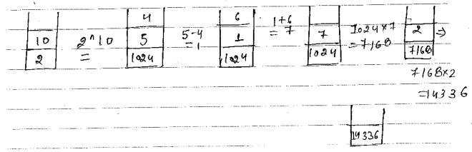
Evaluate the postfix expression

Slide 48
Recursion
A function that calls itself is called a recursive function and this technique is called recursion. A recursive function will call itself until a final call that does not require a call to itself is made. It takes advantage of the system stack to temporarily store the calling function’s return address and local variables.
A recursive function is said to be well-defined if it has the following two properties:
There must be a base criteria in which the function doesn’t call itself.
Every time the function is called itself, it must be closer to the base criteria.

Slide 49
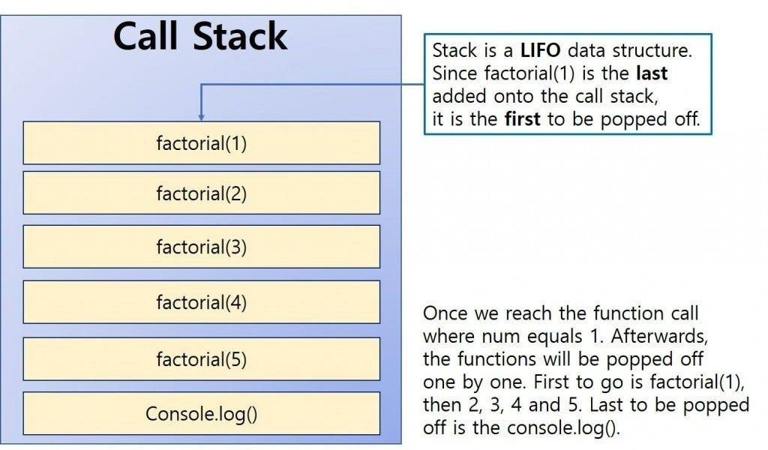


Slide 50
To illustrate recursive functions, consider calculating the factorial of an integer. To find n!, multiply the number by the factorial of the number that is one less than the number.
That is,
n! = n * (n - 1)!
Assume we need to find the value of 5!. Then,
5! = 5 * 4!, where 4! = 4 * 3!
Therefore,
5! = 5 * 4 * 3!
Expanding further, we get
5! = 5 * 4 * 3 * 2 * 1!

